Slide 1


Dept. of CS&E ( DATA SCIENCE)
Adichunchanagiri Institute of Technology Chikkamagaluru - 577102
Mini Project Presentation On
“DATA SCIENCE RESOURCE HUB”
Presented By,
Group no : 13
Pooja Shankar S (4AI23CD036)
Nishmitha K M(4AI23CD034)
Spoorthi H (4AI23CD053)
Dhanushree D.D (4AI23CD016)
Under the Guidance
Prof. Shilpa K.V
of

Slide 2
CONTENTS
Problem Definition
Scope of the Project
Project Design
Work Flow
Methodology
Implementation
Challenges Faced
Result
Conclusion
Future Work

Slide 3
Problem Definition
To design a centralized web-based Resource Hub for the Data Science department to organize notes, question papers, and project materials. Currently, resources are scattered and difficult for students and faculty to access efficiently.
The department does not have a single platform where all study materials are stored. Notes, question papers, and project details are spread across different places, making them hard to find. A centralized website is needed to make accessing and managing these resources easier for students and faculty.

Slide 4
Scope of the Project
Key Areas the Project Focuses On
Centralized academic resource management.
Secure material upload and control for faculty.
Core Functionalities
Faculty login to add, update, or delete study materials.
Simple and user-friendly web interface for smooth navigation.
Expected Impact or Benefits
Convenience: Provides departmental study resources in one platform.
Time-saving: Reduces effort spent searching for scattered materials.

Slide 5
Project Design
Hardware : A computer system with basic configuration and internet access.
Software Components
Frontend:
HTML, CSS, and JavaScript for building a clean and user-friendly interface.
Provides semester-wise navigation for students to access materials.
Backend:
Django framework for handling data processing, authentication, and access control.
Core Functional Modules:
Admin Login: Secure access for faculty to upload, update, or delete files.
Student Access: Direct viewing and downloading of study materials.
System Features
Efficient backend processing for fast performance and reliability.
Ensures centralized access for both students and faculty.

Slide 6
Work Flow
Start
|
User Access Link
|
┌──────────────┴──────────────┐
| |
Faculty Student
| |
Login / Authentication Search
| |
Update / Delete / Add View & Download
| |
End End

Slide 7
Methodology
Identify the need for a centralized platform for academic resources.
Build the backend using Django to manage uploading, storage, and access.
Configure an SQLite database to store uploaded materials in an organized way.
Integrate the frontend, backend, and database for smooth operation.
Test login authentication, file upload/download, and error handling.

Slide 8
Tools And Technology
Languages: Python, HTML, CSS
Frameworks: Django (backend) / CSS (frontend)
Database: SQLite
Libraries: Django
Tools: VS Code

Slide 9
Implementation
Integrated web application for faculty uploads and student access.
Frontend built with HTML, CSS, and JavaScript for a simple UI.
Backend developed using Django for authentication and file handling.
SQLite database used to store uploaded files and maintain records.
Validation ensures only authorized faculty can upload content.

Slide 10
Challenges Faced
Difficulty in managing and storing uploaded academic files securely.
Integrating the backend (Django) smoothly with the SQLite database.
Ensuring fast and organized access to uploaded materials for students.
Designing a simple and easy-to-use interface for both faculty and students.

Slide 11
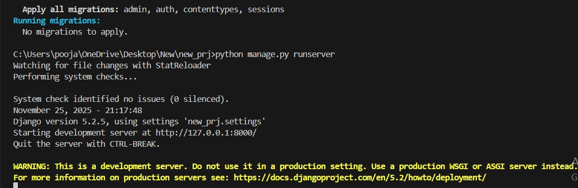
RESULT
Fig: Backend Execution Output

Slide 12
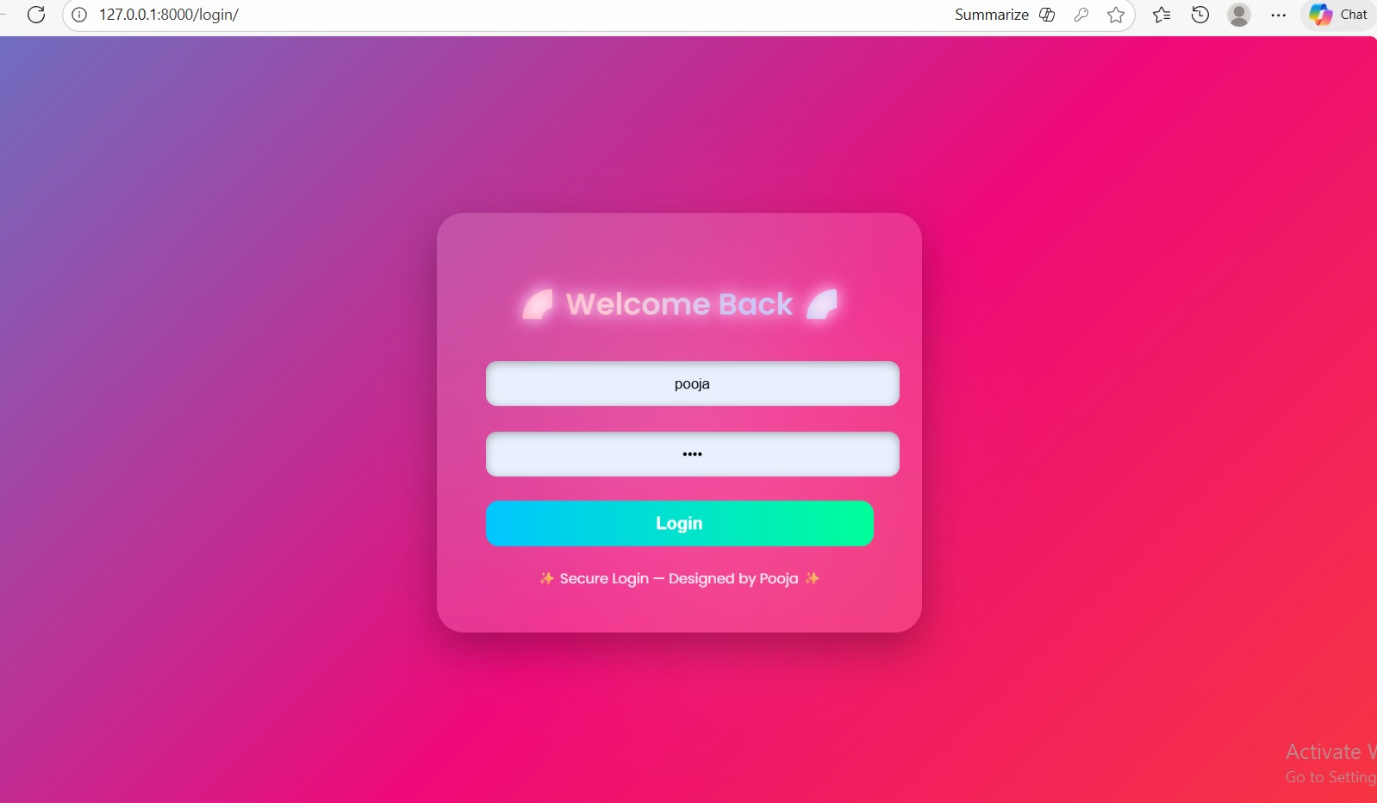
Fig: Login page

Slide 13
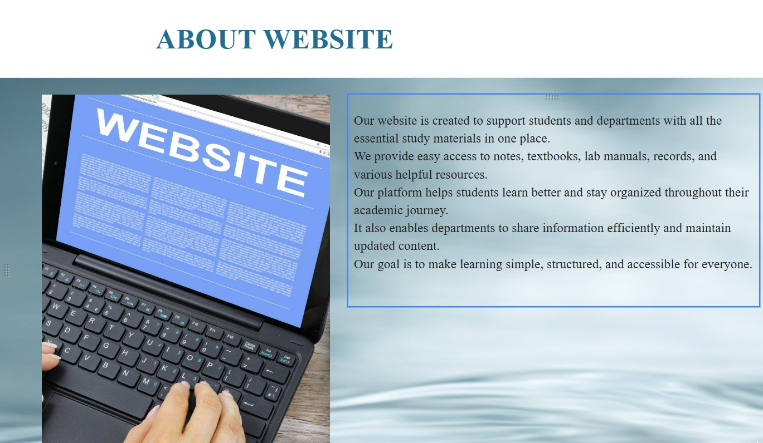
Fig: Website

Slide 14
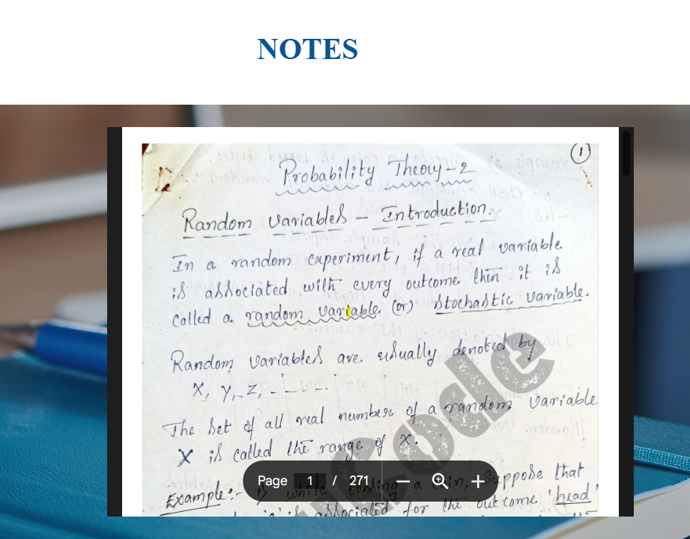
Fig: Study materials

Slide 15
Conclusion
The Department Resource Hub provides a centralized digital platform where faculty can securely upload materials and students can access them anytime through a web link. It saves time, improves coordination, and makes learning more efficient by keeping academic resources organized, accessible, and reliable for the department.

Slide 16
Future Work
Add an advanced search and filter option to find materials faster.
Add automatic notifications when new materials are uploaded.
Integrate a chatbot for student queries and support.
Develop a mobile application for easier access on smartphones

Slide 17
Thank You!

